Slide 1
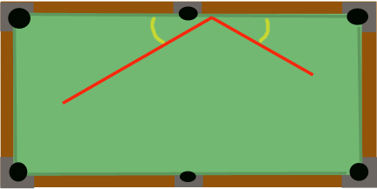
How can you use math to help you in billiards?
Angle of departure
Angle of approach
Angle of approach = Angle of departure

Slide 2
In this lesson you will learn how to write equations for multi-step problems by using facts about angle relationships.

Slide 3
Supplementary angles sum to 180°.

Slide 4
Let’s look at the pool table example.
Angle of departure
Angle of approach
Angle of approach = Angle of departure

Slide 5
Write and solve an equation to solve this problem.
A pool ball hits the side of the table and creates a 120 degree angle. What was the angle of departure?
x
x
120°
2x + 120 = 180
2x = 60
x = 30°

Slide 6
Write and solve an equation to solve this problem.
A pool ball hits the side of the table with a 40° angle of approach. What angle is formed by path of the ball?
x
2(40) + x = 180
80 + x = 180
x = 100°

Slide 7
Write and solve an equation to solve this problem.
What is the measure of angle BCD?
63.2° + n = 180°
66.5° + 50.3° + m = 180°
m = 63.2°
n = 116.8°
n
m
66.5 + 50.3 = 116.8
63.2°

Slide 8
In this lesson you have learned how to write equations for multi-step problems by using the information you know.

